Slide 1

Lecture
on
“Advanced Computer Architecture –TCS 704”
by
Akansha Gupta
DEPARTMENT OF COMPUTER SCIENCE AND ENGINEERING
GRAPHIC ERA DEEMED TO BE UNIVERSITY – 248002

Slide 2
Defining Computer Architecture

Slide 3
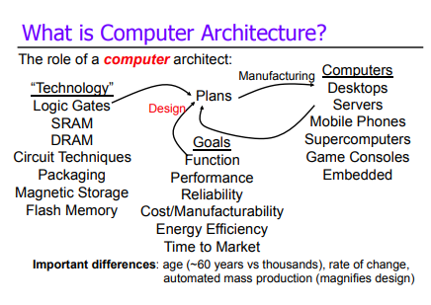

Slide 4
Definition
Computer architecture is a specification describing how hardware and software technologies interact to create a computer platform or system. Computer architecture consists of three main categories.
System design
– This includes all the hardware parts, such as CPU, data processors, multiprocessors, memory controllers and direct memory access. This part is the actual computer system.
Instruction set architecture
– This includes the CPU’s functions and capabilities, the CPU’s programming language, data formats, processor register types and instructions used by computer programmers. This part is the software that makes it run, such as Windows or Photoshop or similar programs.
Microarchitecture
– This defines the data processing and storage element or data paths and how they should be implemented into the instruction set architecture. These might include DVD storage devices or similar devices.

Slide 5
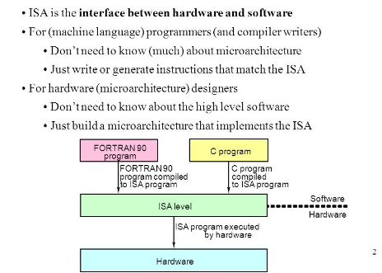
INSTRUCTION SET ARCHITECTURE

Slide 6
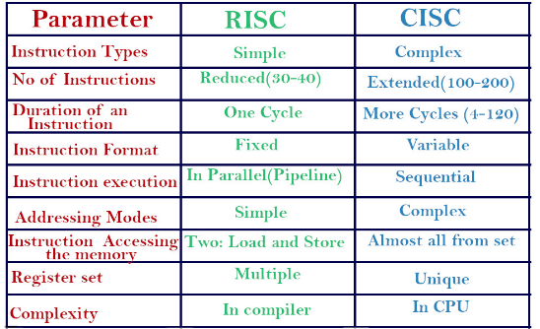
RISC VS CISC

Slide 7
INSTRUCTION SET ARCHITECTURE
The computer ISA defines all of the programmer-visible components and operations of the computer
– memory organization
address space -- how may locations can be addressed?
addressibility -- how many bits per location?
– register set (a place to store a collection of bits)
how many? what size? how are they used?
– instruction set
Opcodes (operation selection codes)
data types (data types: byte or word)
addressing modes (coding schemes to access data)
ISA provides all information needed for someone that wants to write a program in machine language (or translate from a high-level language to machine language).

Slide 8
What Makes a Good Instruction Set?
• implementability
– supports a (performance/cost) range of implementations
– implies support for high performance implementations
• programmability
– easy to express programs
• backward/forward/upward compatibility
– implementability & programmability across generations
– e.g., x86 generations: 8086, 286, 386, 486, Pentium, Pentium II,
– Pentium III, Pentium 4

Slide 9
INSTRUCTION CYCLE
Instruction fetch – Load the next instruction from memory
Instruction decode – transform the bits of the opcode into the CPU configuration necessary to execute it.
Execute – Perform arithmetic operations
Memory – Access memory
Writeback – write results back into destination register

Slide 10
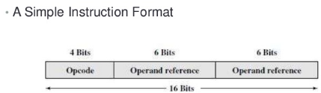
INSTRUCTION FORMAT

Slide 11
WELL KNOWN ISA’S
x86
Based on Intel 8086 CPU in 1978
Intel family, also followed by AMD
X86-64
64-bit extensions
Proposed by AMD, also followed by Intel
ARM
32-bit & 64-bit
Initially by Acorn RISC Machine
ARM Holding
MIPS
32-bit & 64-bit
By Microprocessor without Interlocked Pipeline Stages (MIPS)
Technologies

Slide 12
SPARC
32-bit & 64-bit
By Sun Microsystems
PIC
8-bit to 32-bit
By Microchip
Z80
8-bit
By Zilog in 1976
Many extensions
Intel – MMX, SSE, SSE2, AVX
AMD – 3D Now!

Slide 13
https://youtu.be/vJzEpeaJngU
THANKS

